Slide 1
Why Organize?

Slide 2
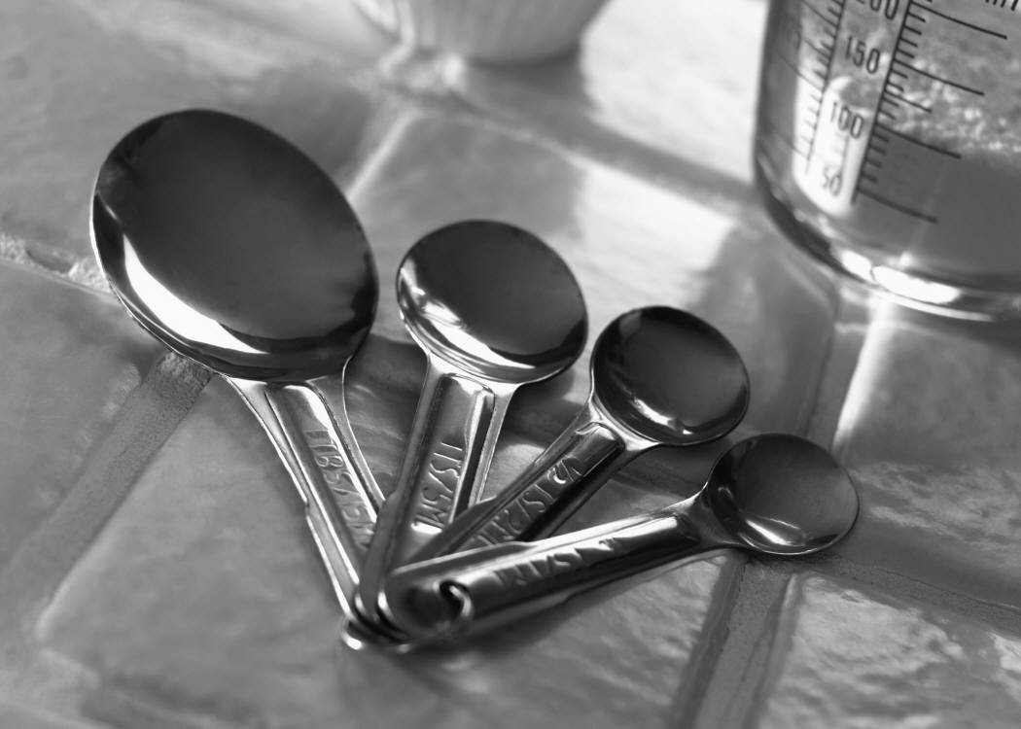
Drawer #1
Equipment you need First

Slide 3
Drawer #2
More than Two

Slide 4
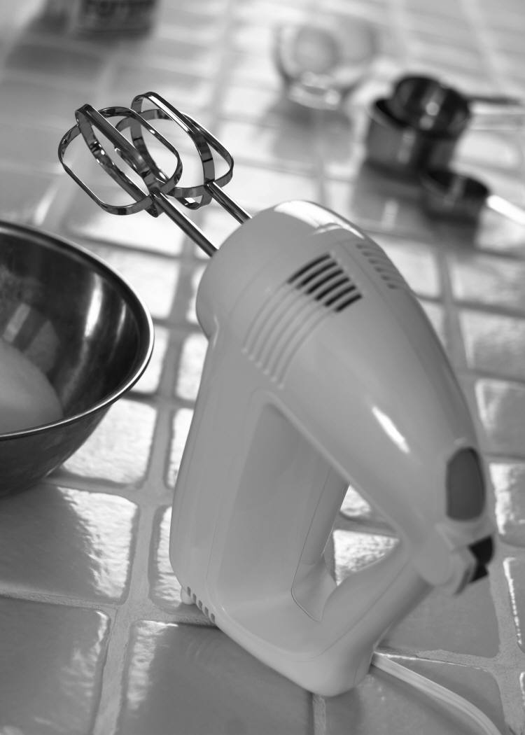
Drawer #3
3 Items
Electric Mixer
2 Beaters

Slide 5
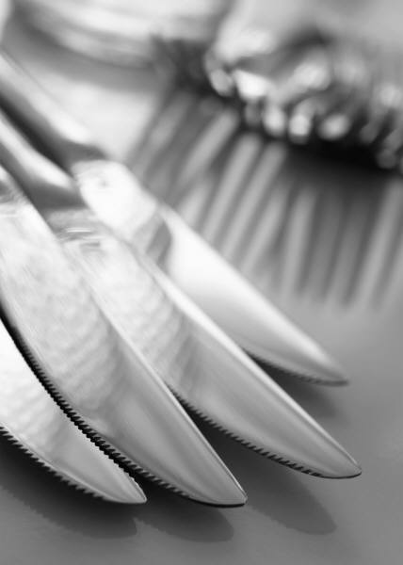
DRAWER #4
Comes in Four

Slide 6
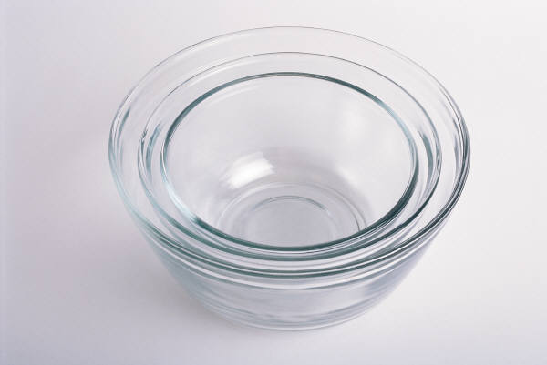
DRAWER #5
Everything is Round

Slide 7
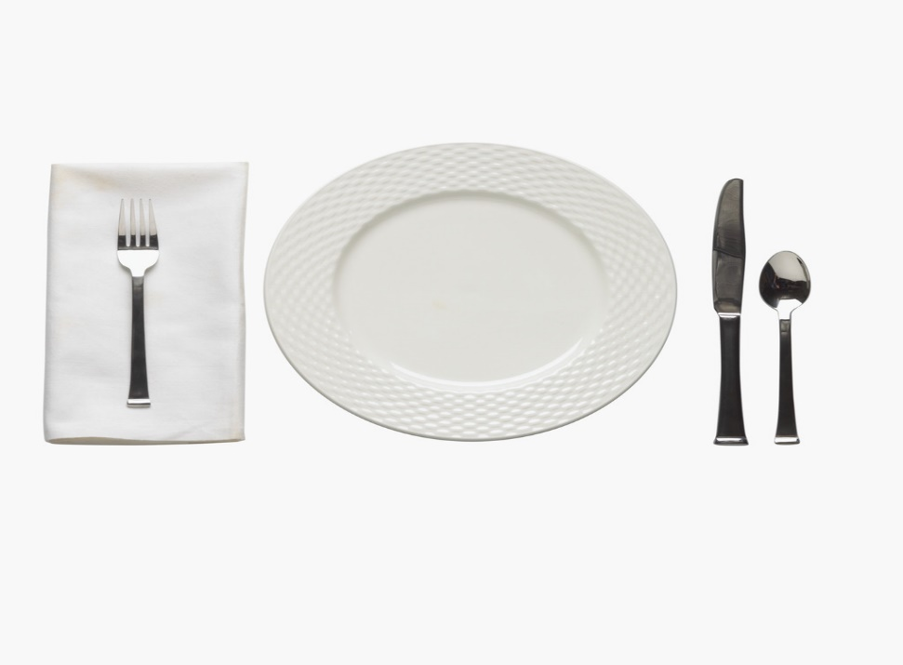
DRAWER#6
6 things when
when setting
the table

Slide 8
DRAWER #7
Under the sink

Slide 9

Drawer #8
Holds Liquid

Slide 10
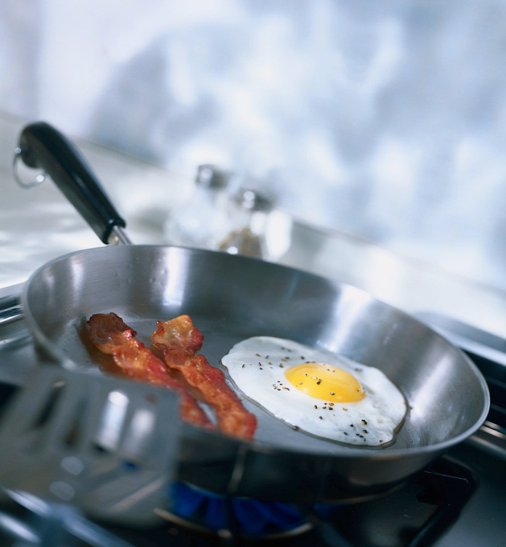
Drawer #9
Stovetop

Slide 11
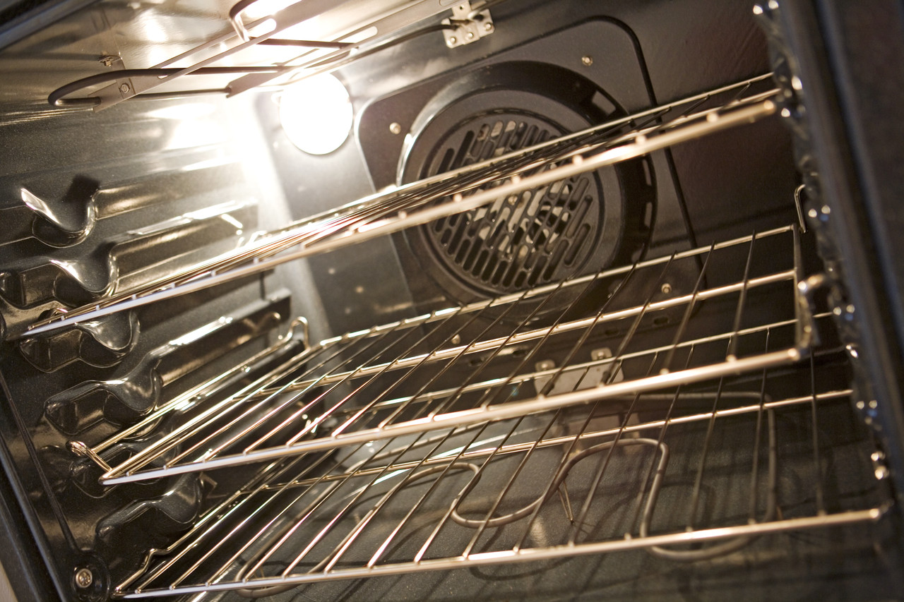
DRAWER #10
OVEN

Slide 12
Drawer #11
Protects

Slide 13
Drawer #12
2 PARTS

Slide 14
Drawer #13
TRAY

